Slide 1


Green loop
REDUCE, RECYCLE, REUSE
Group Members:
Abhishek Katiyar 230029014007
Abhijeet Singh 230029014003
Ankit Mishra 230029014025
Anup Yadav 230029014030
Mentor:
Dr.Ankit Verma

Slide 2

introduction
Users can list their electronic waste.
Other users or shopkeepers can purchase these items directly.
Shopkeepers can place bulk orders, reducing their collection efforts and costs

Slide 3

modules
User Authentication Module : Handles user registration, login, password recovery, and profile management.
Product Management Module : Allows users to list, view, edit, and delete products for sale or recycling.
Recycling Management Module : Manages the recycling process, including scheduling pickups, tracking recycled items, and providing information on recycling procedures.
Admin Panel Module : Enables administrators to manage users, products, transactions, and monitor recycling operations.
Marketplace Module : This module facilitates the listing, viewing, and purchasing of both upcycled products and new items, supporting a circular economy.

Slide 4
literature review
Introduction to E-Waste
Rapid increase in electronic waste globally (74 million metric tons by 2030).
Significant environmental and health risks due to improper disposal.
Need for effective management and recycling solutions.
MERN Technology Overview
MongoDB: Flexible NoSQL database for storing user and transaction data.
Express.js: Web application framework for efficient server-side development.
React: Dynamic front-end library for an interactive user interface.
Node.js: JavaScript runtime for scalable server-side applications.

Slide 5

Objective
Encourage Eco-Friendly Choices: Promote sustainable habits among users.
Simplify Recycling Process: Make recycling easy and accessible for everyone.
Reward User Engagement: Offer credits or cashback for recycling items.
Provide Upcycled Marketplace: Create a platform for buying new and upcycled products.
Raise Awareness: Educate users on the importance of recycling and sustainability.

Slide 6
workflow
1
Request Handling
3
Admin Dashboard
5
E-Waste Disposal
2
4
6
User Interaction
Data Storage & Management
Real-Time Updates

Slide 7

FACTS
Total E-Waste Generated : In 2023, approximately 59.4 million metric tons (Mt) of e-waste were generated globally . By 2030, it is expected to reach 74.7 million metric tons, growing at an annual rate of 3-4%.
E-Waste Per Person : On average, each person generates about 7.6 kg of e-waste annually.
Recycling Rates : Only 17.4% of global e-waste was officially documented as properly recycled in 2022.The remaining 82.6% is often discarded improperly, leading to environmental and health hazards.
Economic Impact : E-waste contains valuable materials such as gold, silver, copper, and platinum, worth an estimated $57 billion annually . A significant amount of these materials is lost due to improper recycling practices.

Slide 8
FEATURES
To minimize the environmental impact of e-waste.
To create an online platform for e-waste exchange.
To enable shopkeepers to order e-waste directly from users, saving time and costs.
Easy and convenient recycling process.
Contribution to environmental sustainability.

Slide 9
The Environmental Impacts of E-Waste
P
Pollution : E-waste contains hazardous materials, such as lead, mercury, and cadmium . These substances can leach into soil and water sources , contaminating ecosystems and endangering human health.
Climate Change : The production and disposal of electronic devices contribution to greenhouse gas emissions, accelerating climate change.
Resource Depletion : E-waste represents a loss of valuable resources, including precious metals and other materials used in electronic devices.

Slide 10
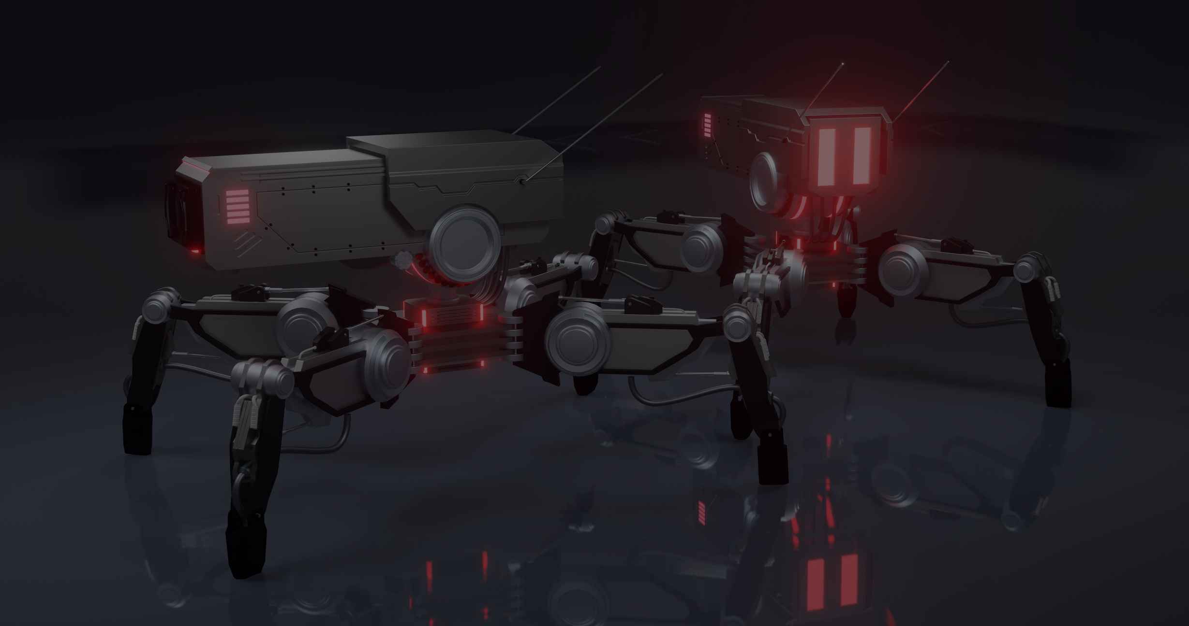
references
W3Schools:"HTML, CSS, JavaScript, and More." Access comprehensive tutorials and resources on web development technologies at W3Schools.
GeeksforGeeks:"Understanding the Circular Economy and Its Impact." Explore articles on sustainability and coding practices at GeeksforGeeks.
MDN Web Docs:"Web Development Documentation." Find detailed documentation and guides on web technologies at MDN Web Docs.
FreeCodeCamp:"Learn to Code for Free." Access a variety of coding tutorials and projects, including e-commerce solutions, at FreeCodeCamp.
Stack Overflow:"Community Q&A for Developers." Get answers to coding questions and challenges related to your project at Stack Overflow.

Slide 11
FUTURE GOALS
Expand Global Reach : Target international markets to promote e-waste recycling globally, Partner with global NGOs, governments, and environmental organizations.
Build a Zero-Waste Ecosystem: Create partnerships with manufacturers to offer repair and refurbishment options.
Integration With IOT : Create partnerships with manufacturers to offer repair and refurbishment options.

Slide 12
THANK YOU

